Slide 1
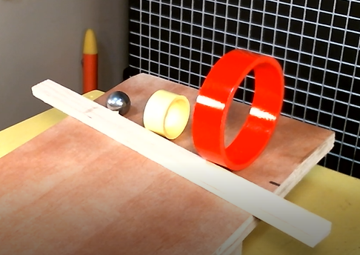
Dynamics
Kinetic Energy of Rolling Objects
LabRat Scientific
© 2019

Slide 2
Relationship Between Linear Velocity and Rotational Velocity
For every revolution of the disk, the disk will move a distance that is equivalent to the disk’s circumference.

Slide 3
Relationship Between Linear Velocity and Rotational Velocity
For every revolution of the disk, the disk will move a distance that is equivalent to the disk’s circumference.

Slide 4
Relationship Between Linear Velocity and Rotational Velocity
For every revolution of the disk, the disk will move a distance that is equivalent to the disk’s circumference.

Slide 5
Relationship Between Linear Velocity and Rotational Velocity
For every revolution of the disk, the disk will move a distance that is equivalent to the disk’s circumference.

Slide 6
Relationship Between Linear Velocity and Rotational Velocity
For every revolution of the disk, the disk will move a distance that is equivalent to the disk’s circumference.

Slide 7
Relationship Between Linear Velocity and Rotational Velocity
For every revolution of the disk, the disk will move a distance that is equivalent to the disk’s circumference.

Slide 8
Relationship Between Linear Velocity and Rotational Velocity
For every revolution of the disk, the disk will move a distance that is equivalent to the disk’s circumference.

Slide 9
Relationship Between Linear Velocity and Rotational Velocity
For every revolution of the disk, the disk will move a distance that is equivalent to the disk’s circumference.

Slide 10
Relationship Between Linear Velocity and Rotational Velocity
For every revolution of the disk, the disk will move a distance that is equivalent to the disk’s circumference.

Slide 11
Relationship Between Linear Velocity and Rotational Velocity
So, if a 1.0 meter circumference disk is rolling along at 1 revolution/sec, it will lay out the 1.0 meter long red dashed line in one second.
This means that the Center of Mass of the disk will also have moved to the right 1.0 meter in that same second.
This allows us to conclude that the Center of Mass has a velocity of 1.0 m/sec…
1.0 m/sec
Circumference

Slide 12
Relationship Between Linear Velocity and Rotational Velocity
From this simple mind experiment, we can establish a relationship between the Linear Velocity and the Rotational Velocity:
Velocity_{Linear} = Velocity_{Rotational} x Circumference
1.0 m/sec
Circumference

Slide 13
Unit assessment:
Velocity_{Linear} = Velocity_{Rotational} x Circumference
Rev 1 Circumference
Velocity_{Linear} = ------- x ------------------------
sec Rev
1
Velocity_{Linear} = -------- x Circumference
sec
1 m
Velocity_{Linear} = -------- x m = -------
sec sec
The proper units are obtained…

Slide 14
However, engineers don’t typically work in “rev/sec” - it makes more mathematical sense to work in the unitless “radian” when dealing with motion around a circle. Engineers typically assign “ꙍ“ to represent Rotational Velocity…
This means Rotational Velocity (ꙍ) needs to be converted into Radians/sec. Recall from geometry:
1 Revolution = 360 Deg = 2∏ Radians
So, the units of Rotational Velocity become:
Revolution 2∏ Radians
ꙍ = ---------------- = ----------------
sec sec

Slide 15
But the units of ꙍ need to be in “Radians/sec” , not “2∏ Radians/sec”…
2∏ Radians
ꙍ = -----------------
sec
The desired unitary result can be achieved by dividing each side of the equation by “2∏” :
ꙍ 2∏ Radians
------ = -----------------
2∏ 2∏ sec
Radians
= ---------------
sec

Slide 16
From basic geometry, the circumference of the disk is calculated as follows:
Circumference = ∏ x Diameter
Diameter = 2 x Radius
So, circumference can be expressed as:
Circumference = ∏ x 2 x Radius
Or, in shorthand notation:
Circumference = 2∏ R

Slide 17
Inserting the new definitions for the various parameters into the Linear Velocity equation yields:
Velocity_{Linear} = Velocity_{Rotational} x Circumference
ꙍ
Velocity_{Linear} = -------- x 2∏ R
2∏
Cancelling terms yields the following:
Velocity_{Linear} = ꙍ R

Slide 18
And finally, establishing a variable for Linear Velocity:
Linear Velocity = v
The relationship between Linear Velocity and Rotational Velocity can be now be expressed in a relatively simple equation:
v = ꙍ R

Slide 19
Kinetic Energy
The two types of mechanical Kinetic Energy involved with translating and rolling bodies are as follows:
Linear Kinetic Energy: KE = ½ m v²
Where “I” is the moment of inertia about the axis of rotation.
Rotational Kinetic Energy: KE = ½ I ꙍ²
The total Kinetic Energy of a system that is translating and rotating at the same time is the sum of the Linear and Rotational Kinetic Energies. As such, the total KE for an object rolling down an incline is as follows:
KE_{Total} = ½ I ꙍ² + ½ m v²

Slide 20
From earlier slides, rotational velocity and linear velocity are related via the following equation:
v = ꙍ R
And thus:
v
ꙍ = -----
R
This allows the Total Kinetic Energy of a translating and rolling body to be expressed in terms of just linear velocity. Performing the necessary insertion, the KE equation becomes:
KE_{Total} = ½ I (v/R)² + ½ m v²

Slide 21
Moments of Inertia (a sample)
m R²
I = ------------
2
Solid Cylinder
m
I = ------- (R₁² + R₂²)
2
Thick-walled Tube
2 m R²
I = ------------
5
Solid Sphere

Slide 22
Conservation of Energy
Just as with a free falling body, energy is conserved in rolling objects. So if a rolling object starts from a stand still and then rolls down an include, the initial Potential Energy is equal to the final Kinetic Energy once the object is at height = 0.
All Potential Energy
Height
Height = 0
All Kinetic Energy

Slide 23
Conservation of Energy
By applying Conservation of Energy to a rolling object, we can determine the linear velocity of the object after “dropping” a certain vertical distance.
Potential Energy (PE) = Kinetic Energy (KE)
mgh = ½ I (v/R)² + ½ m v²
The right-hand side of the equation needs to be solved for “v”:
v²
mgh = ½ I ------ + ½ m v²
R²
I
= ½ v² ------ + m
R²

Slide 24
I
mgh = ½ v² ------- + m
R²
Divide each side by ½. Then divide each side again by the terms in the parentheses…
2mgh
------------------ = v²
I
------ + m
R²

Slide 25
The equation to solve for linear velocity becomes:
It’s not obvious from this equation, but since the Moment of Inertia (I) for the object is a function of the object’s mass (m) the linear velocity of the object is independent of its mass – just like with a free falling body…
Note: Do the math by substituting an appropriate equation for Moment of Inertia. The “m” in the denominator will factor out and then cancel the “m” in the numerator.
2mgh
------------------
v =
I
------ + m
R²

Slide 26
Sample Calculations
R₁ = 0.05 m
R₂ = 0.058 m
I = ( m/2 ) x ( R₁² + R₂² )
= (0.069 kg / 2) x ( (0.05 m)² + (0.058 m)² )
= 0.0345 kg x 0.00586 m²
= 0.000202 kg m²
Mass = 0.069 kg
10 cm (0.1 m) vertical drop
2mgh
------------------
2 x 0.069 kg x 9.8 m/sec² x 0.1 m
------------------------------------------------
v =
=
= 1.02 m/sec
I
------ + m
R²
0.000202 kg m²
----------------------- + 0.069 kg
(0.058 m)²

Slide 27
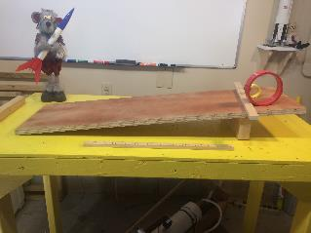
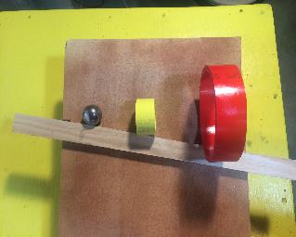
Validation Experiments
Three test articles were used:
Large diameter PCV Tube
Small diameter PVC Tube
Solid metal sphere
The starting stick was not parallel to the top of the inclined plane. The angle was selected so that the axes of rotation of the test articles were aligned. This made the “fall distances” the same.
Starting Stick

Slide 28
Theoretical Predictions
Note: While the masses and diameters of the PVC Tubes are quite different, the final velocities are nearly the same. It’s possible, due to slight variations in the release, that the PVC Tubes will alternate in which one reaches the bottom first.

Slide 29
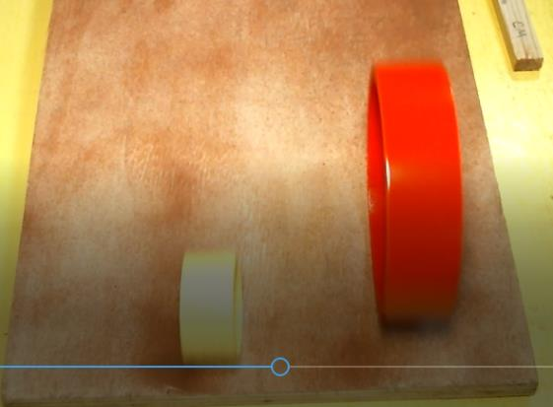
Results
Here are the positions of the two PVC Tubes at the bottom of the incline. Notice how the smaller object’s axis of rotation is in front of the other indicating it was moving faster. Sometimes they were a little closer together and sometimes a little farther apart (since the theoretical velocities were so close to one another).
Note: The sphere had already reached the bottom…

Slide 30
Results
Theoretical Results:
The metal sphere had the highest predicted velocity at the bottom of the ramp and thus would win the race. The two PVC tubes had very similar final velocities, with the small tube being slightly higher.
Experimental Results:
The metal sphere reached the bottom of the ramp first, and thus must have had the highest velocity. The two PVC tubes reached the bottom at nearly the same time, with the small tube winning “by a hair” most of the time. These results are consistent with the theoretical prediction.

Slide 31
What’s Going on with the Two PVC Tubes
The large diameter PVC tube has a much higher total inertia, so its rotation doesn’t speed up as fast as the small tube. However, the large diameter allows it to cover a greater distance for a give angular rotation.

Slide 32
Questions ?

